Slide 1

SUMMIT ON CLIMATE CHANGE:
September 13, 2022 Session with Professor Bart Elmore

Slide 2


Slide 3
“But with the global success rate for sustainability initiatives at only 4%, many leaders know they need to do substantially more.”
Source: Bain & Company, “Sustainability Is the Next Digital,” 2020

Slide 4
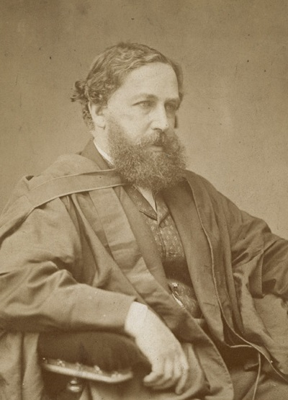
William Stanley Jevons,
economist and author of
The Coal Question
published in 1865
Source: Wikipedia

Slide 5
Source: Delta Airlines Annual Reports

Slide 6
Source: Delta Airlines Annual Reports

Slide 7
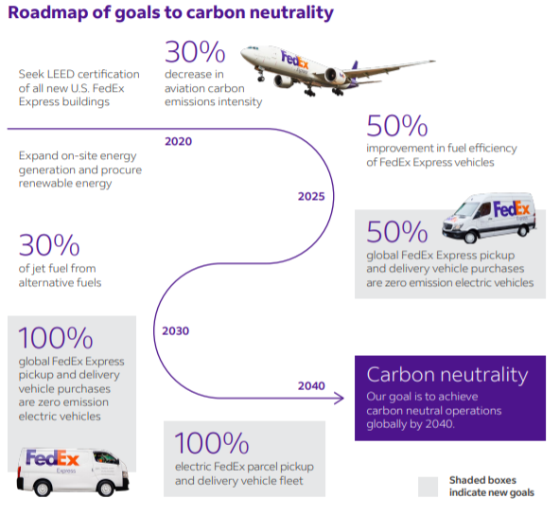
Source: 2020 FedEx Annual Report

Slide 8
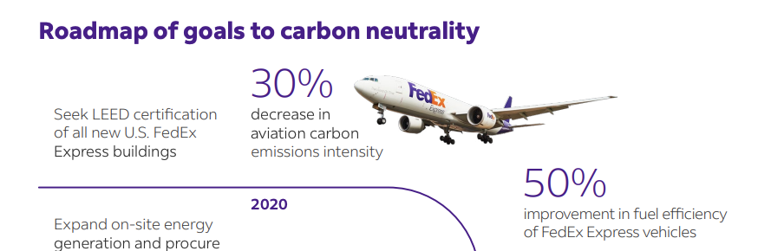
Source: 2020 FedEx Annual Report

Slide 9
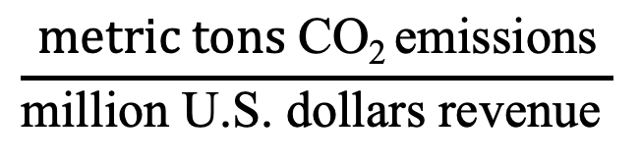
Carbon Intensity
$$\frac{metric tons \text{CO}\text{2 }\text{emissions}}{\text{million} \text{U}\text{.}\text{S}\text{. }\text{dollars} \text{revenue} }$$
=

Slide 10
What can history teach us about avoiding the worst of the environmental problems we face?

Slide 11
Be more honest in our corporate sustainability assessments

Slide 12
Invite your critics into the conversation

Slide 13
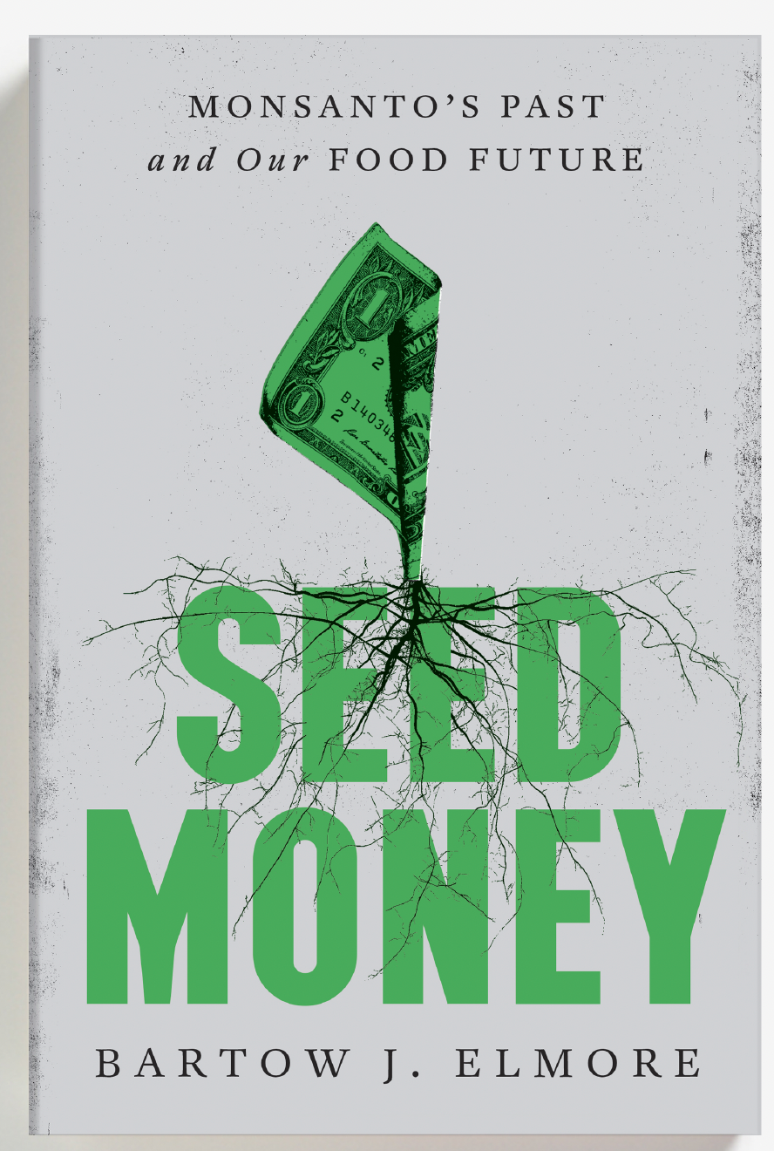

Slide 14
Source: Wikimedia

Slide 15
Source: Scribbled notes from confidential
Monsanto ad hoc committee meeting,
October 1969.

Slide 16
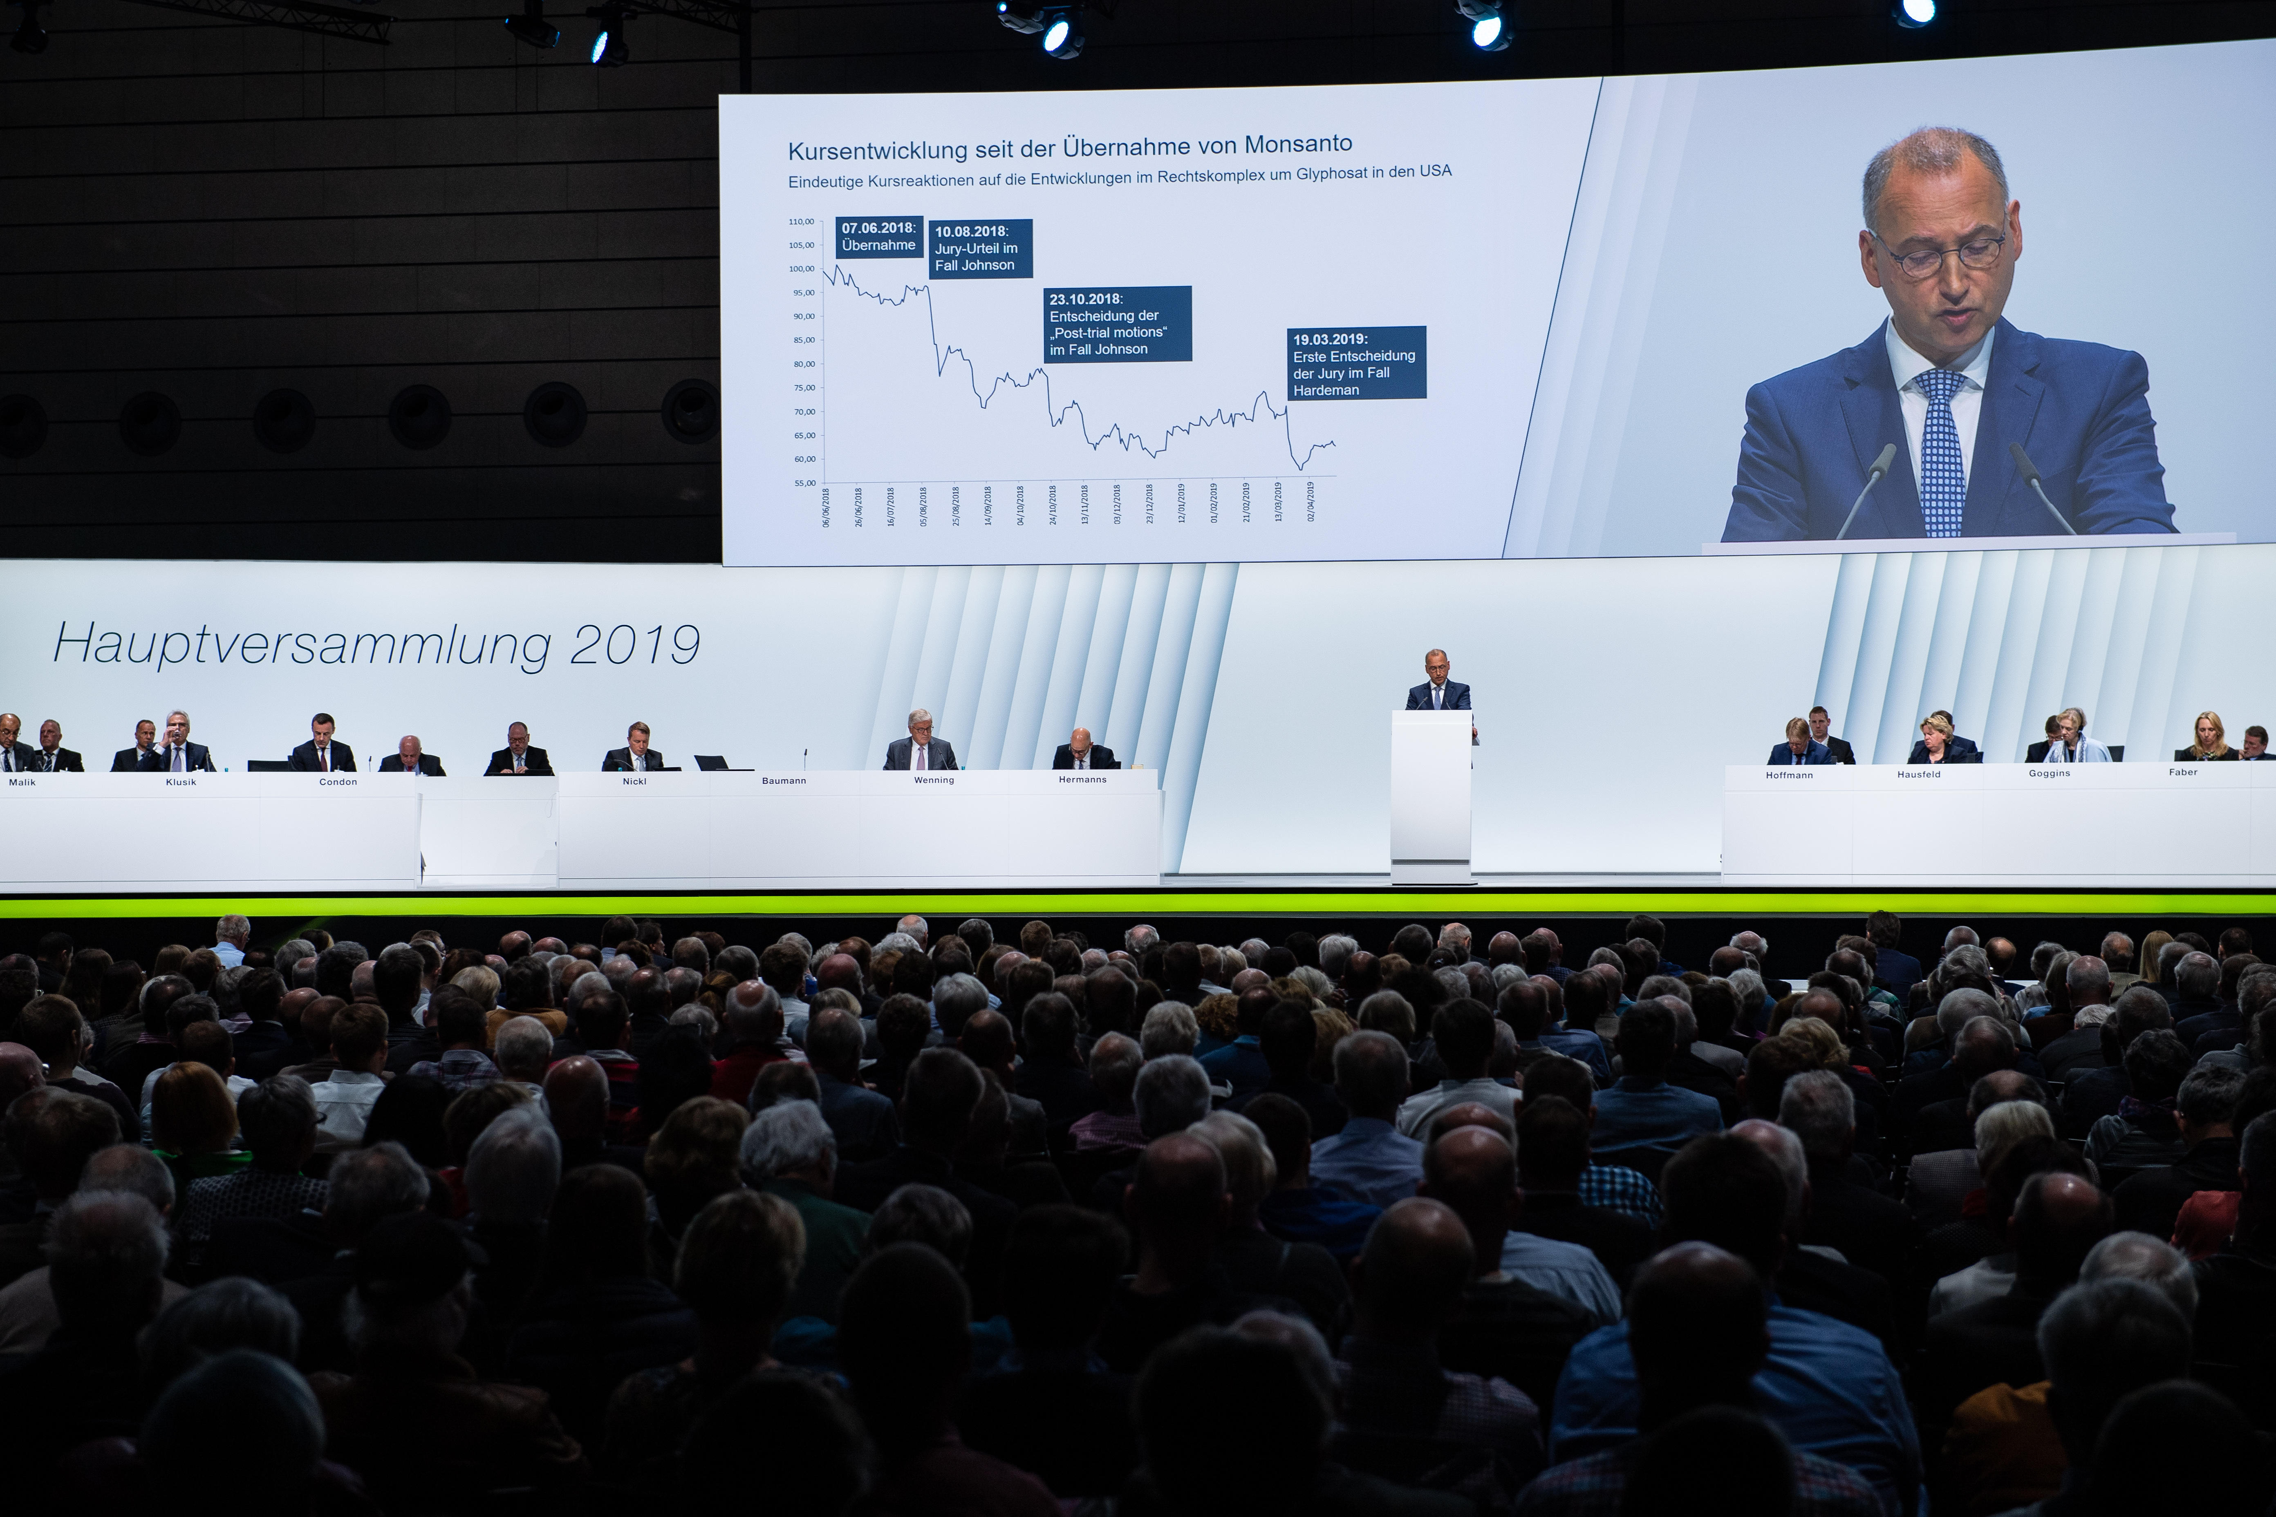
Source: dpa picture
alliance/Alamy stock

Slide 17
SUMMIT ON CLIMATE CHANGE:
September 13, 2022 Session with Professor Bart Elmore

